Slide 1
CS 331
More about Classes
MD Romael Haque

Slide 2
Enumerated Data Types
An enumerated data type in C++ is a programmer-defined data type whose legal values are a set of named integer constants.
So far we have used data types that are built into the C++ language, such as int and double, and object types, like string, which are provided by C++ classes.
However, C++ also allows programmers to create their own data types.

Slide 3
Enumerated Data Types
An enumerated data type is a programmer-defined data type whose only legal values are those associated with a set of named integer constants.
It is called an enumerated type because the named constants are enumerated, or listed, as part of the definition of the data type.
Here is an example of an enumerated-type declaration.
enum Roster { Tom, Sharon, Bill, Teresa, John };
This creates a data type named Roster.

Slide 4
Enumerated Data Types
Because the word enum is a C++ key word, it must be in lowercase.
However, notice that the data type name itself begins with a capital letter. Although this is not required, most programmers do capitalize this name.
The named integer constants associated with the Roster data type are called enumerators.
A variable of the Roster data type may only have one of the values associated with these enumerators. But what are their values?
By default, the compiler sets the first enumerator to 0, the next one to 1, and so on.
In our example then, the value of Tom would be 0, the value of Sharon would be 1, and so forth. The final enumerator, John, would have the value 4. Later in this section you will learn how to associate different values with these named constants if you wish.

Slide 5
Enumerated Data Types
It is important to realize that the example enum statement does not actually create any variables. It just defines the data type.
It says that when we later create variables of this data type, this is what they will look like - integers whose values are limited to the integers associated with the symbolic names in the enumerated set.
The following statement shows how a variable of the Roster data type would be defined.
Roster student;

Slide 6
Enumerated Data Types
The form of this statement is like any other variable definition: first the data type name, then the variable name.
Notice that the data type name is Roster, not enum Roster.
Now that the student variable has been created, it can be assigned a value, like this:
student = Sharon;
The value of the variable could then be tested like this:
if (student == Sharon)
Notice in these two examples that there are no quotation marks around Sharon because it is a named constant, not a string literal.

Slide 7
Enumerated Data Types
Even though the values in an enumerated data type are actually stored as integers, you cannot always substitute the integer value for the symbolic name.
For example, we could not have assigned Sharon as the value of student like this:
student = 1; // Error!
You can, however, test an enumerated variable by using an integer value instead of a symbolic name. For example, because Bill is stored as 2, the following two if statements are equivalent.
if (student == Bill)
if (student == 2)

Slide 8
Enumerated Data Types
You can also use relational operators to compare two enumerated variables.
For example, the following if statement determines if the value stored in student1 is less than the value stored in student2:
if (student1 < student2)
If student1 equals Bill, which is stored as 2, and student2 equals John, which is stored as 4, this statement would be true. However, if student1 equals Bill and student2 equals Sharon, which is stored as 1, the statement would be false.

Slide 9
Enumerated Data Types
As mentioned earlier, the symbols in the enumeration list are assigned the integer values 0, 1, 2, and so forth by default. If this is not appropriate, you can specify the values to be assigned, as in the following example.
enum Department { factory = 1, sales = 2, warehouse = 4 };
Remember that if you do assign values to the enumerated symbols, they must be integers. The following value assignments would produce an error.
enum Department { factory = 1.0, sales = 2.0, warehouse = 4.0 }; // Error!

Slide 10
Enumerated Data Types
Although there is no requirement that assigned integer values be placed in ascending order, it is generally considered a good idea to do so.
If you leave out the value assignment for one or more of the symbols, they will be assigned default values, as illustrated by the following two examples.
enum Colors { red, orange, yellow = 9, green, blue };
In this example, the named constant red will be assigned the value 0, orange will be 1, yellow will be 9, green will be 10, and blue will be 11.
enum Rooms { livingroom = 1, den, bedroom, kitchen };
In this example, livingroom will be assigned the value 1, den will be 2, bedroom will be 3, and kitchen will be 4.

Slide 11
Enumerated Data Types
One purpose of an enumerated data type is that the symbolic names help to make a program self-documenting.
However, because these names are not strings, they are for use inside the program only.
Using the Roster data type defined at the beginning of this section, the following two statements would output a 2, not the name Sharon.
Roster topStudent = Sharon;
cout << topStudent;
Because the symbolic names of an enumerated data type are associated with integer values, they may be used in a switch statement. Let’s look at an example -

Slide 12
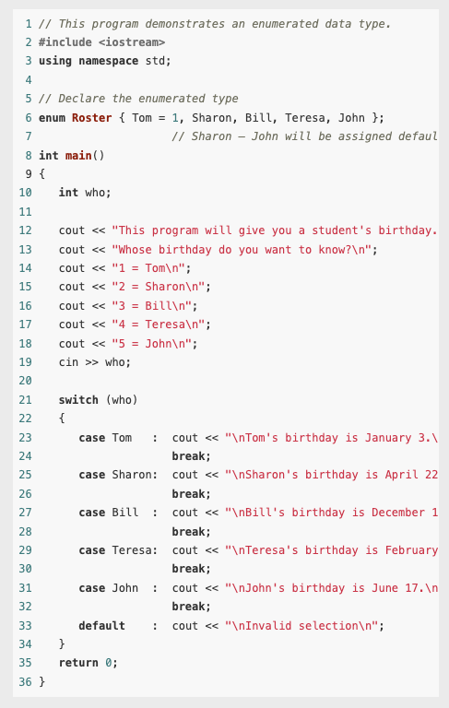
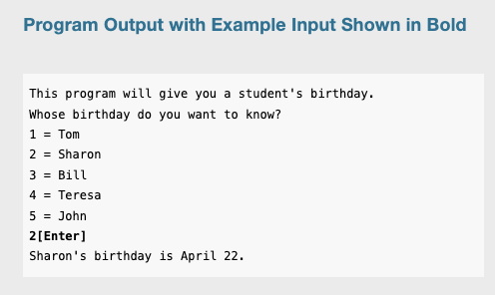
Example

Slide 13
Declaring an enum Data Type and Defining Variables All in One Statement
The following code uses two lines to declare an enumerated data type and define a variable of the type.
enum Car { PORSCHE, FERRARI, JAGUAR };
Car sportsCar;
However, C++ allows you to declare an enumerated data type and define one or more variables of the type in the same statement. So the previous code could be written like this:
enum Car { PORSCHE, FERRARI, JAGUAR } sportsCar;
The following statement declares the Car data type and defines two variables, myCar and yourCar.
enum Car { PORSCHE, FERRARI, JAGUAR } myCar, yourCar;

Slide 14
Assigning an Integer to an enum Variable
Even though the enumerators of an enumerated data type are stored in memory as integers, you cannot directly assign an integer value to an enum variable.
enum Day { MONDAY, TUESDAY, WEDNESDAY, THURSDAY, FRIDAY }; Day today;
We could now write the following assignment statement:
today = THURSDAY;
But the following statement is illegal and will produce an error message if you try to compile it.
today = 3; // Error!

Slide 15
Assigning an Integer to an enum Variable
When assigning a value to an enum variable, you should use a valid enumerator.
However, if circumstances require that you store an integer value in an enum variable, you can do so by casting the integer to the enum data type. Here is an example:
today = static_cast<Day>(3);
This statement will produce the same results as:
today = THURSDAY;

Slide 16
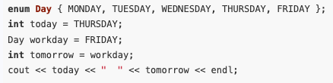
Assigning an Enumerator to an int Variable
Although you cannot directly assign an integer value to an enum variable, you can directly assign an enumerator to an integer variable.
For example, the following code will work just fine.
When this code runs it will display 3 4.

Slide 17

Using Math Operators to Change the Value of an enum Variable
Even though enumerators are really integers and enum variables really hold integer values, you can run into problems when trying to perform math operations with them.
For example, look at the following code.
The third statement causes a problem because the expression day1 + 1 results in the integer value 2. The assignment operator then attempts to assign the integer value 2 to the enum variable day2. Because C++ cannot implicitly convert an int to a Day, as previously discussed, an error occurs.

Slide 18
Using Math Operators to Change the Value of an enum Variable
We can fix this by using a cast as we did above to explicitly convert the result to the Day data type, as shown here:
day2 = static_cast<Day>(day1 + 1); // This works

Slide 19
Using Enumerators to Output Values
As we have already seen, sending an enumerator to cout causes the enumerator’s integer value to be displayed.
For example, assuming we are using the Day type previously described, the following statement displays 0.
cout << MONDAY << endl;

Slide 20
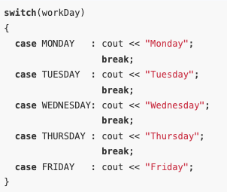
Using Enumerators to Output Values
If we wish to use the enumerator to display a string such as “Monday,” we’ll have to write code that produces the desired string.
For example, if workDay is a Day variable that has been initialized to some value, the following switch statement displays the name of a day, based on the value of the variable.

Slide 21
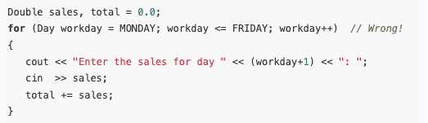
Using Enumerators to Control a Loop
Because enumerators are stored in memory as integers, we can use them to control how many iterations a loop should perform.
However, as discussed, we cannot assign the result of a math operation to an enumerator without first casting the result to its enum data type.
Therefore, we cannot use the ++ or –– operators directly on an enum variable. These code will not work.

Slide 22

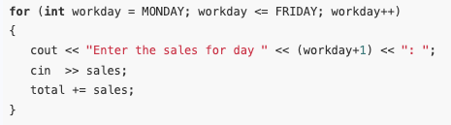
Using Enumerators to Control a Loop
We can solve the problem by changing the for statement to the following:
However, it is simpler to make the loop control variable an int. Then you can write the loop like this:

Slide 23
Using Strongly Typed enums
C++ does not allow multiple enumerators with the same name within the same scope.
That is, the same enumerator name cannot be a member of two different enumerated data types defined or used in the same scope.
However, C++ 11 includes a new type of enum, known as a strongly typed enum (also known as an enum class), to get around this limitation.

Slide 24
Using Strongly Typed enums
Here are two examples of a strongly typed enum declaration:
enum class Presidents { MCKINLEY, ROOSEVELT, TAFT };
enum class VicePresidents { ROOSEVELT, FAIRBANKS, SHERMAN };
When you use a strongly typed enumerated data type, however, you must prefix every enumerator you reference with the name of the enum it belongs to, followed by the :: operator. Here are three examples:
Presidents prez = Presidents::ROOSEVELT;
VicePresidents vp1 = VicePresidents::ROOSEVELT;
VicePresidents vp2 = VicePresidents::SHERMAN;

Slide 25
Using Strongly Typed enums
Strongly typed enumerators are stored as integers, like regular enumerators.
However, if you want to retrieve a strongly typed enumerator’s underlying integer value, you must use a cast operator.
Here is a few examples
int x = static_cast<int>(Presidents::ROOSEVELT);
cout << static_cast<int>(Presidents::ROOSEVELT) << " " << static_cast<int>(Presidents::TAFT) << endl;

Slide 26
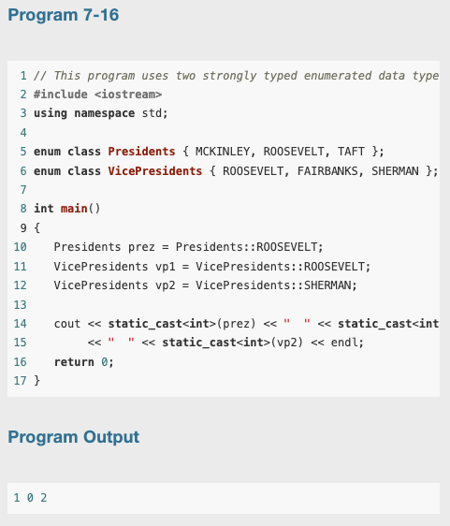
Using Strongly Typed enums

Slide 27
Static Members
If a member variable is declared static, all objects of that class have access to that variable.
If a member function is declared static, it may be called before any instances of the class are defined.

Slide 28
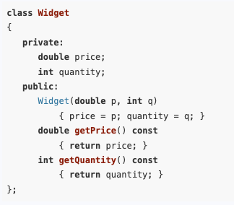
Static Members
By default, each class object (an instance of a class) has its own copy of the class’s member variables.
An object’s member variables are separate and distinct from the member variables of other objects of the same class.

Slide 29

Static Members
Now, Assume that in a program, two separate instances of the Widget class are created by the following declaration:
Widget w1(14.50, 100), w2(12.75, 500);
This statement creates w1 and w2, two distinct objects. Each has its own price and quantity member variables.
cout << w1.getQuantity() << " " << w2.getQuantity();
//will return the value 100 500

Slide 30
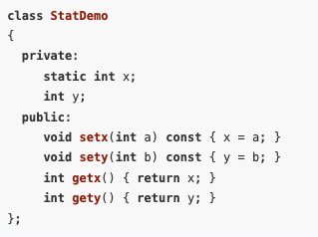
Static Member Variables
It’s possible to create a member variable that is shared by all the objects of the same class.
To create such a member, simply place the key word static in front of the variable declaration

Slide 31
Static Member Variables
Now we define x outside class
int StatDemo::x;
In this example, the member variable x will be shared by all objects of the StatDemo class.
When one class object puts a value in x, it will appear in all other StatDemo objects.

Slide 32
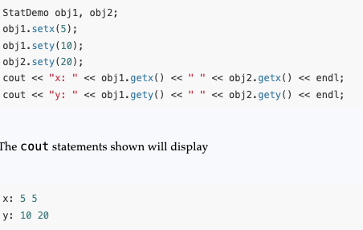
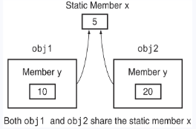
Static Member Variables
Now we define x outside class
int StatDemo::x;
In this example, the member variable x will be shared by all objects of the StatDemo class.
When one class object puts a value in x, it will appear in all other StatDemo objects.

Slide 33
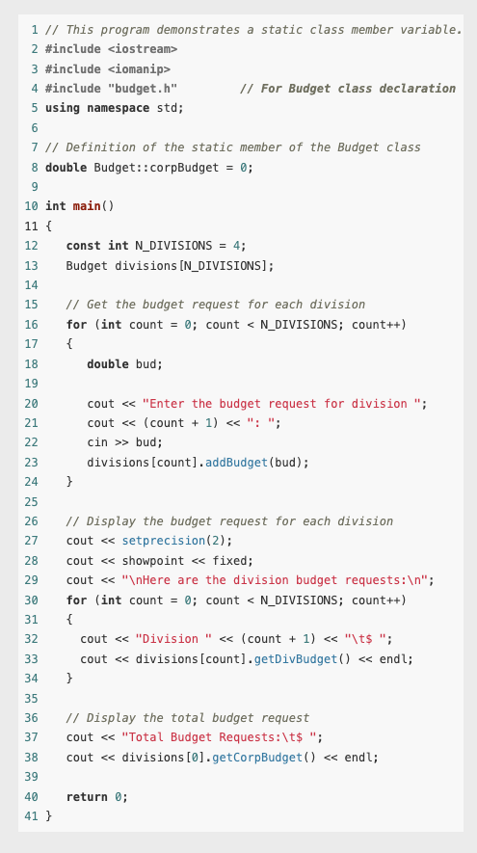
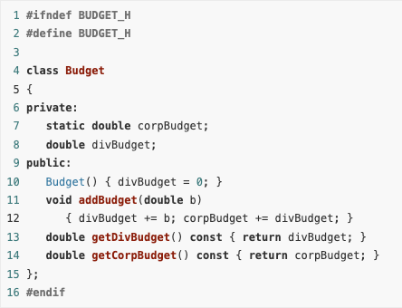
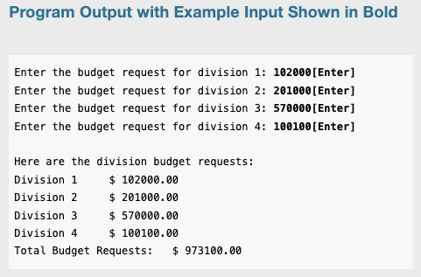
Example

Slide 34
Static Member Variables
Static member variables furnish a good example of the distinction between C++ declarations and C++ definitions.
A declaration provides information about the existence and type of a variable or function.
A definition provides all the information contained in a declaration and, in addition, causes memory to be allocated for the variable or function being defined.
Static member variables must be declared inside the class and defined outside of it.

Slide 35
Static Member Variables
In general, we can divide the member variables and functions of a class into two groups: instance members and static members.
An instance member is one whose use must be associated with a particular instance of the class. In particular, an instance variable of a class must be accessed through a specific instance of its class, and an instance member function must be called through a specific instance of its class.
In contrast, the use of a static member variable, or the call of a static member function, does not need to be associated with any instance. Only the class of the static member needs to be specified.

Slide 36
Static Member Functions
A member function of a class can be declared static by prefixing its declaration with the key word static.
static <return type><function name>(<parameter list>)
Static member functions are normally used to work with static member variables of the class. In fact, member functions that do not access any nonstatic members of their class

Slide 37
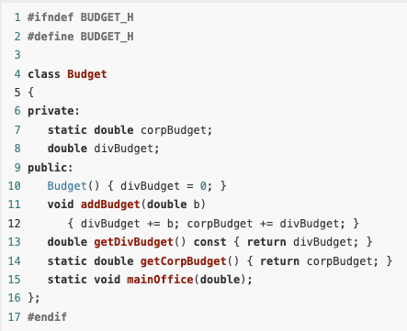
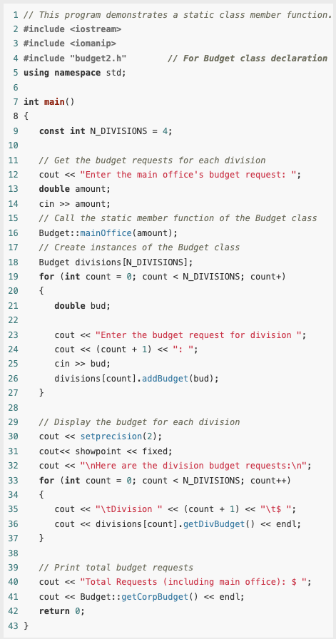
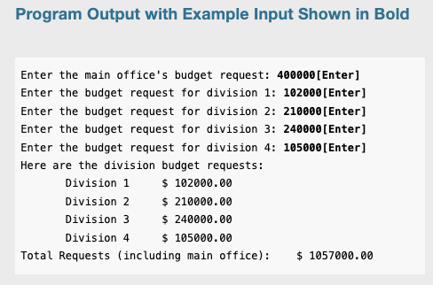
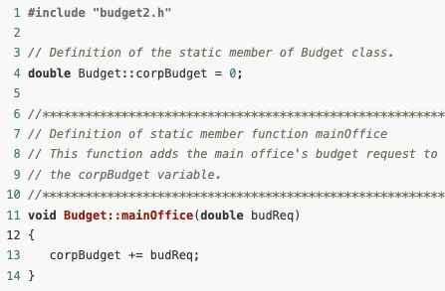
Example

Slide 38
Example
Notice the statement that calls the static function mainOffice:
Budget::mainOffice(amount);
Calls to static member functions are normally made by connecting the function name to the class name with the scope resolution operator.
If objects of the class have been defined, static member functions can also be called by connecting their names to the object with the dot operator.
Thus, the last output statement of yhis program could be written as
cout << divisions[0].getCorpBudget() << endl;

Slide 39
Static member function
The this pointer cannot be used in a static member function because static member functions are not called through any instance of their class.
Moreover, a static member function cannot access an instance member of its class unless it specifies what instance the member belongs to.

Slide 40
Static member function
An advantage of static member functions is that they can be called before any instances of the class have been created.
This allows them to be used to perform complex initialization tasks that have to be done before objects of the class have been created.

Slide 41
Static Members
C++ uses the key word static to describe both static class members and static local variables.
To understand why, it is helpful to look at the distinction between instance and static class members.
Each object of the class has its own copy of the instance members, but all objects share the same static members.
Similarly, each call to a function has its own copy of the non-static local variables, but all function calls share the same static local variables.
In this analogy, the function definition corresponds to the class, function calls correspond to objects of the class, and non-static local variables correspond to instance members.

Slide 42
Friends of Classes
Private members are hidden from all parts of the program outside the class, and accessing them requires a call to a public member function.
Sometimes you will want to create an exception to that rule.
A friend function is a function that is not a member of a class but that has access to the class’s private members.
In other words, a friend function is treated as if it were a member of the class. A friend function can be a regular stand-alone function, or it can be a member of another class. (In fact, an entire class can be declared a friend of another class.)

Slide 43
Friends of Classes
In order for a function or class to become a friend of another class, it must be declared as such by the class granting it access.
Classes keep a “list” of their friends, and only the external functions or classes whose names appear in the list are granted access.
A function is declared a friend by placing the key word friend in front of a prototype of the function. Here is the general format:
friend <return type><function name>(<parameter type list>);

Slide 44
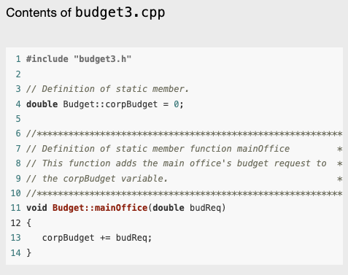
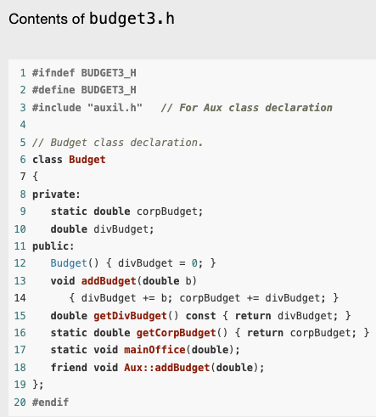
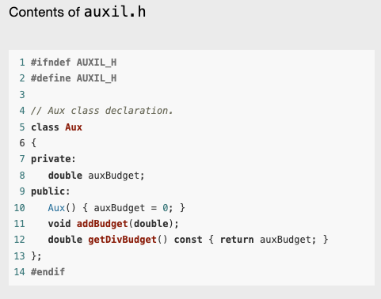
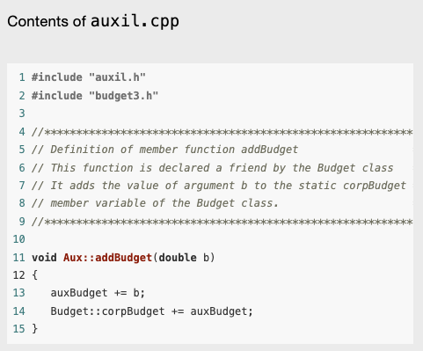
Example

Slide 45
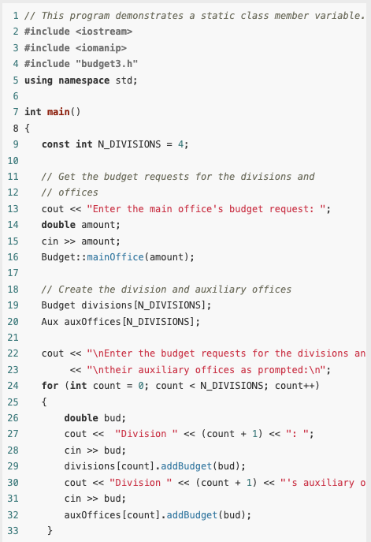
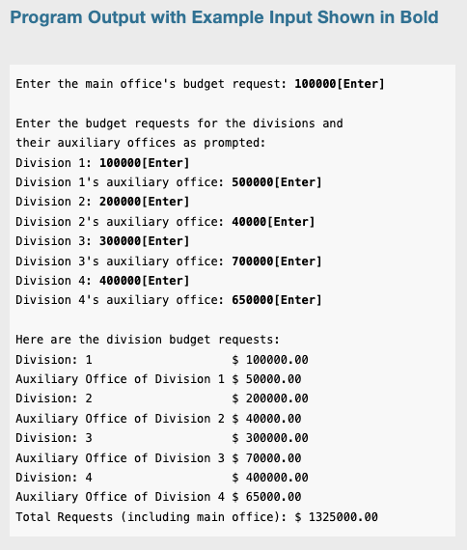
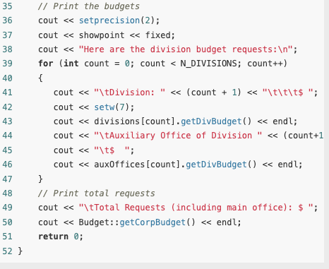
Example (contd.)

Slide 46
Friends of Classes
As mentioned before, it is possible to make an entire class a friend of another class. The Budget class could make the Aux class its friend with the following declaration:
friend class Aux;
This may not be a good idea, however. Every member function of Aux (including ones that may be added later) would have access to the private members of Budget.
The best practice is to declare as friends only those functions that must have access to the private members of the class.

